Slide 1
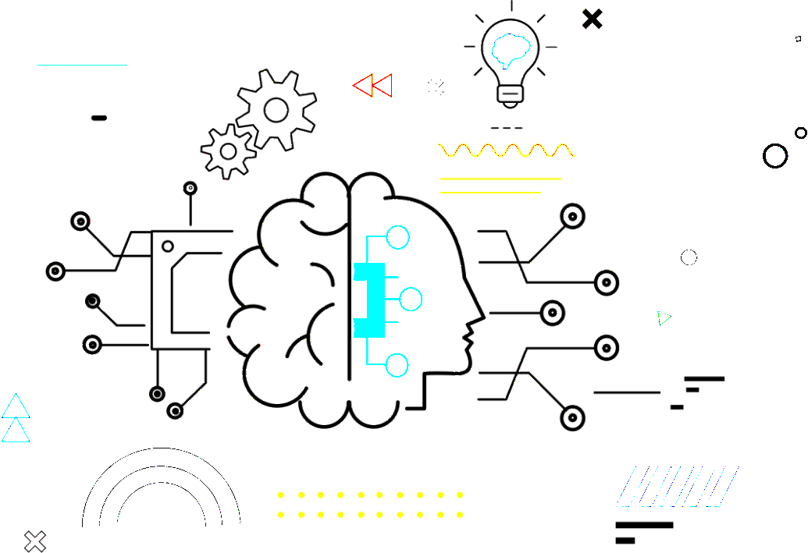

DATA SCIENCE
نام و نام خانوادگی:ارائه دهنده: علی میرسلیمانی
نام استاد:دکتر عصایی

Slide 2
Table of Contents
Introduce data science …………………….. 3
Related to Data science ...……………………. 5
Applications ……………………….. 6
Skills ...…………………...... 8
Conclusion ..……………………….. 10

Slide 3
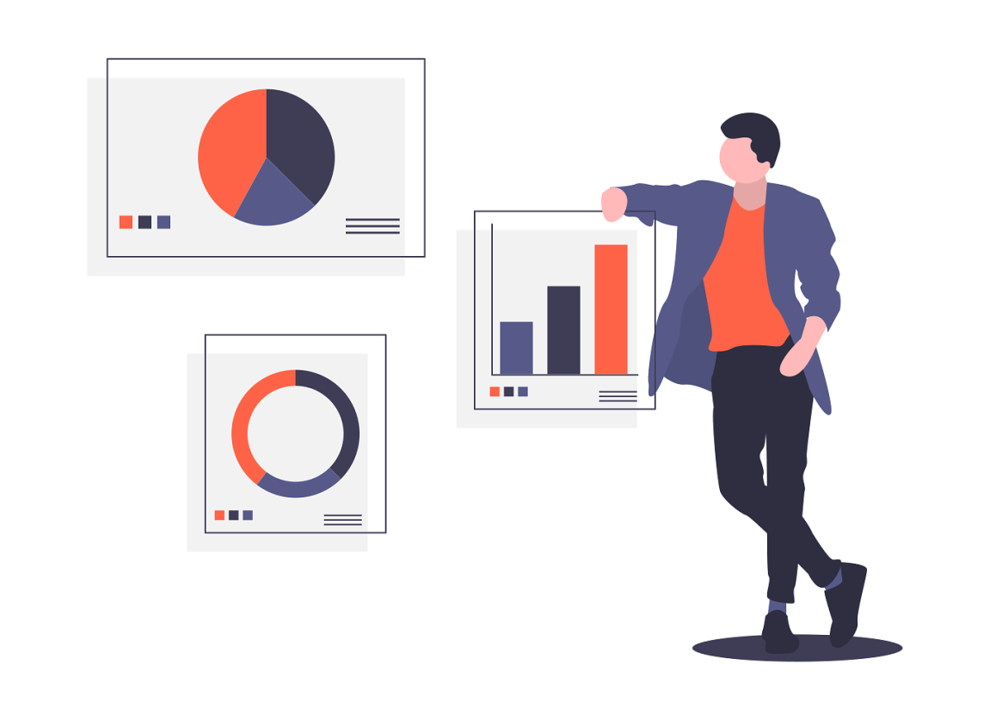
What is
DATA SCIENCE?

Slide 4
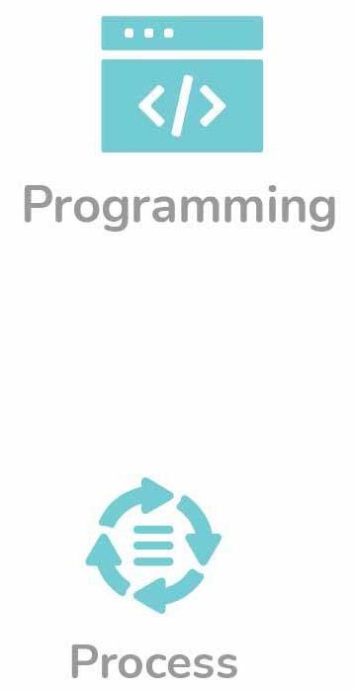

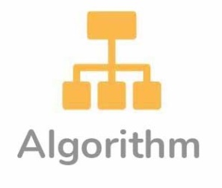
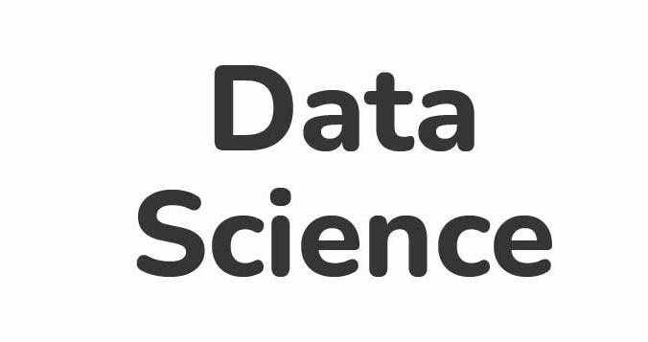
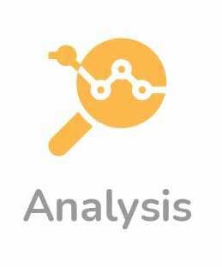
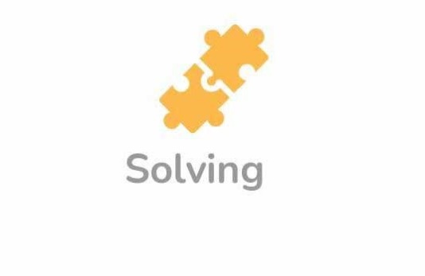


Slide 5
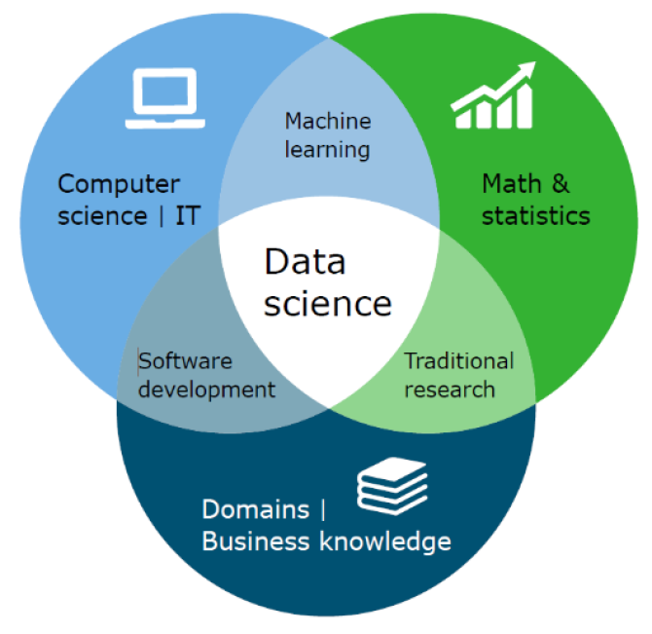

Slide 6

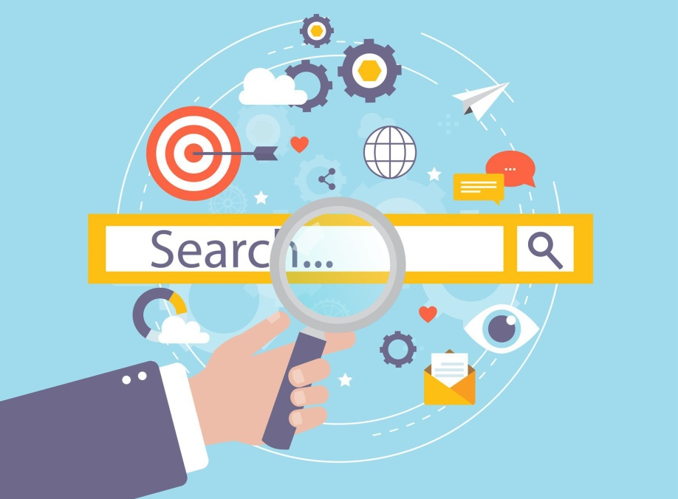
1. Search Engines
2. healthcare

Slide 7
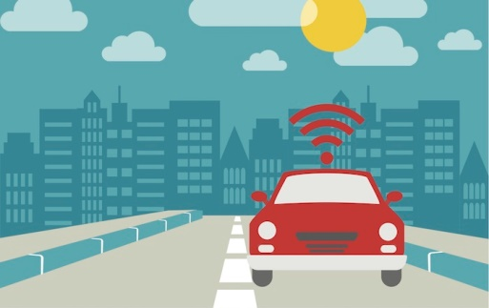

3. Transport
4. E-Commerce

Slide 8
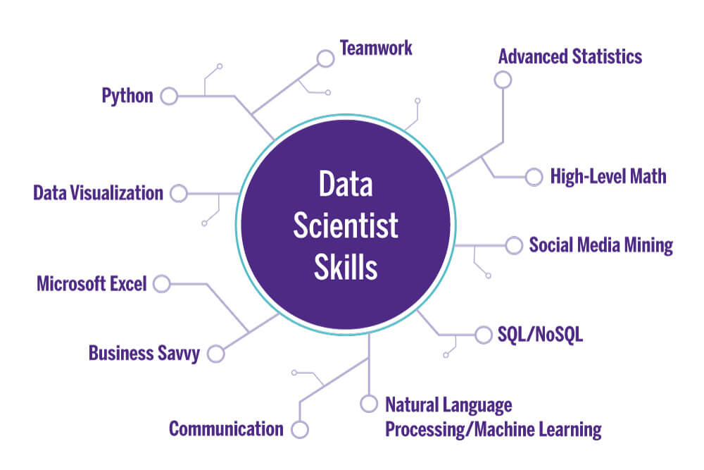
Skilled data scientist

Slide 9

Future Prospects

Slide 10
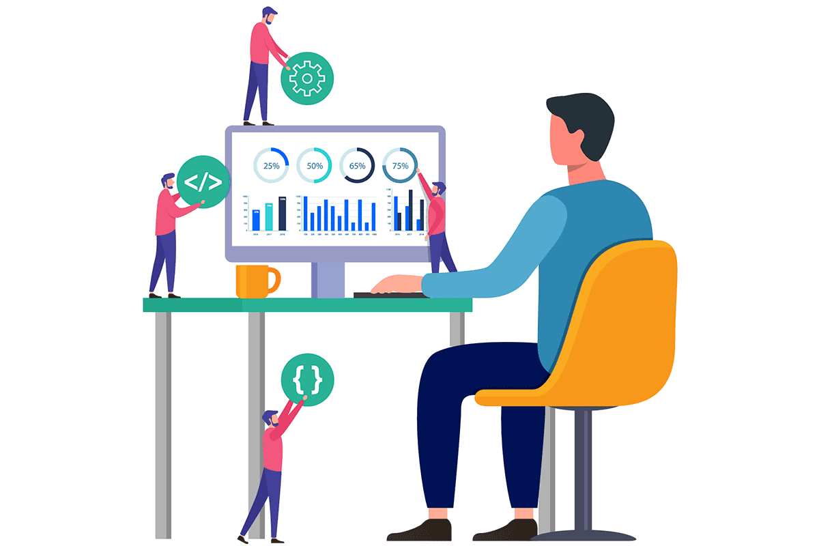
Thanks for your attention
Resources
https://en.wikipedia.org/wiki/Data_science
https://www.udacity.com
https://blog.dataiku.com
https://medium.com/@SravanCynixit/data-science-applications
https://www.geeksforgeeks.org/major-applications-of-data-science/

